Slide 1


Financial
Analysis
By : Shakti Singh Shekhawat

Slide 2


What is
Power BI is a business intelligence and data visualization tool developed by
Microsoft. It is designed to help businesses transform raw data from various sources
into meaningful and interactive insights. Power BI is a collection of software services,
apps, and connectors that work together to turn your unrelated sources of data into
coherent, visually immersive, and interactive insights
Data Analysis Expressions (DAX) is a powerful formula language used in Power BI,
Power Pivot in Excel, and SQL Server Analysis Services (SSAS). DAX is designed to
work with relational data and allows users to create custom calculations and
aggregations on data models

Slide 3


Problem statement
Running Total of Credit Card Transactions
Calculate the 4-week moving average of the creditLimit for
each client.
Calculate the mom% growth and wow% growth on
transaction amount.
Calculate Customer Acquisition Cost (CAC) as a Ratio of
Transaction Amount.
Calculate the yearly average of avg_utilization_ratio for all
clients.
Calculate the percentage of Interest_Earned compared to
Total_Revolving_Bal for each client.
Calculate Top 5 Clients by Total Transaction Amount.
Identify clients whose Avg_Utilization_Ratio exceeds 80%.
Customer Churn Indicator: Create a KPI that flags clients
who have not made any transactions (Total_Trans_Amt = 0)
in the last 6 months.
Delinquency Rate: Calculate the percentage of clients with Delinquent_Acc > 0.
Credit Risk Score: Create a score for each client based on
their Avg_Utilization_Ratio, Delinquent_Acc, and
Total_Revolving_Bal.
Income vs Credit Limit Correlation: Show the correlation
between Income and Credit_Limit for all clients.
Average Customer Satisfaction Score by Credit Card
Category: Calculate the average Cust_Satisfaction_Score
by Card_Category.
Loan Approval vs Credit Limit: Analyze how Credit_Limit
affects Personal_loan approval by calculating the average
credit limit for clients with and without loans.
High Risk Clients Flag: Create a flag for clients whose
Total_Revolving_Bal exceeds 90% of their Credit_Limit

Slide 4


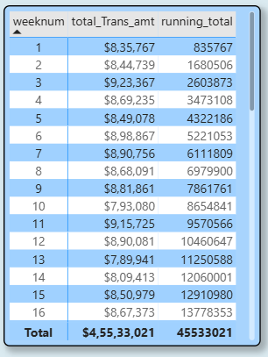

Running Total of Credit Card
Transactions

Slide 5
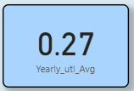
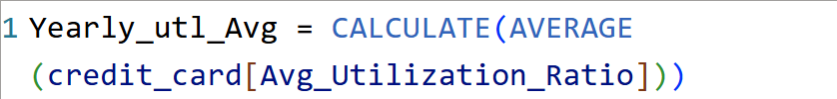
Calculate the yearly average of
avg_utilization_ratio for all clients.

Slide 6
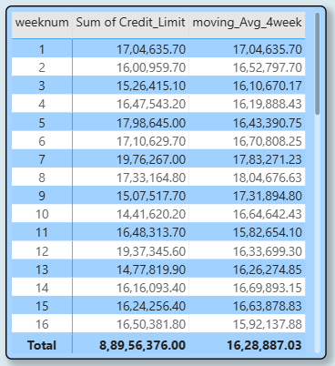
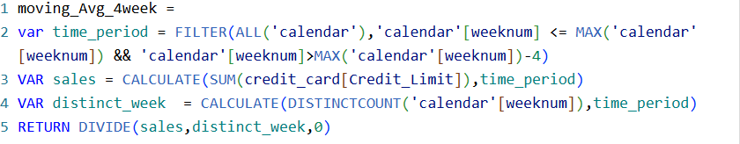
4-week moving average of the
creditLimit for each client.

Slide 7
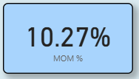
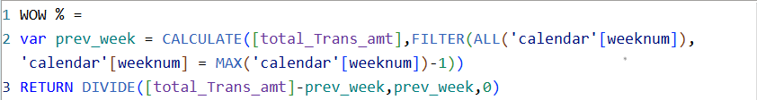
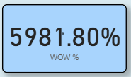
Calculate the mom% growth and wow%
growth on transaction amount.

Slide 8
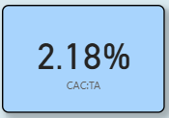
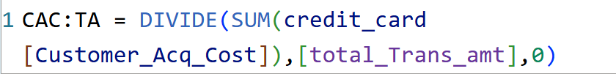
Calculate Customer Acquisition Cost
(CAC) as a Ratio of Transaction Amount.

Slide 9
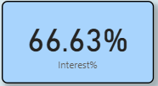
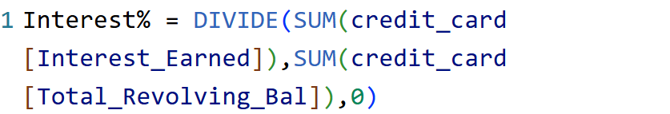
Calculate the percentage of Interest_Earned
compared to Total_Revolving_Bal for each client

Slide 10
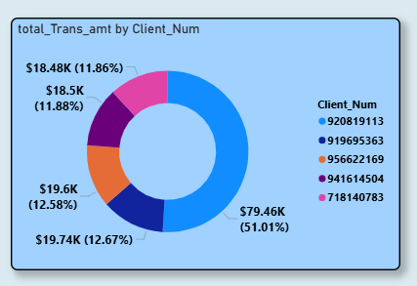
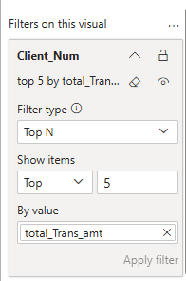

Calculate Top 5 Clients by Total
Transaction Amount.

Slide 11
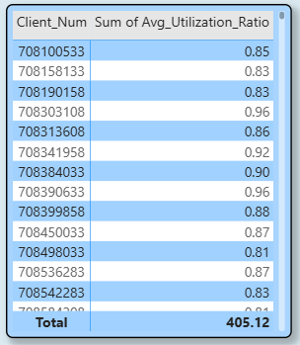
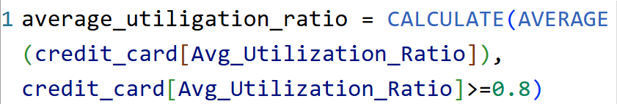
Identify clients whose
Avg_Utilization_Ratio exceeds 80%.

Slide 12
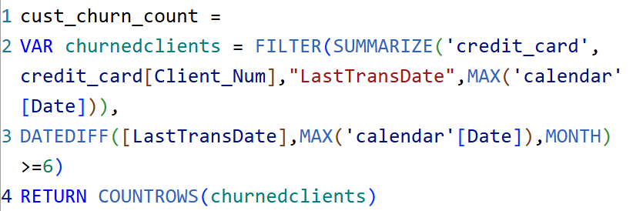
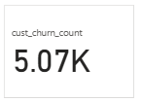
Customer Churn Indicator: Create a KPI that flags
clients who have not made any transactions
(Total_Trans_Amt = 0) in the last 6 months.

Slide 13
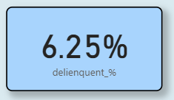
Delinquency Rate: Calculate the percentage
of clients with Delinquent_Acc > 0

Slide 14
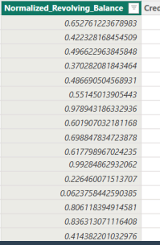
Credit Risk Score: Create a score for each
client based on their Avg_Utilization_Ratio,
Delinquent_Acc, and Total_Revolving_Bal.
Why Normalize First?
Balances alone don’t tell the full story!
A ₹10,000 balance is risky for someone with a ₹15,000 limit (67% used)
The same ₹10,000 is safe for someone with a ₹1,00,000 limit (10% used)
Normalization fixes this by converting balances to percentages of each person’s limit, making scores fair and accurate.

Slide 15

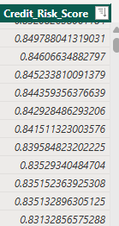
After that, we created the another
column which contain the sum of “Avg_Utilization_Ratio” Product by 0.5,
“Delinquent_Acc” product by 0.3 and “Normalized_Revolving_Balance” product by 0.2 (All the ratios are decided by organization).
These ratios are important in risk scoring because they directly reflect an individual's credit behavior and financial health, indicating their likelihood of defaulting on obligations

Slide 16
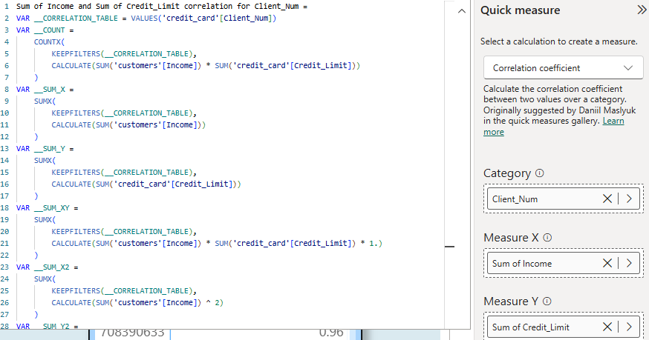
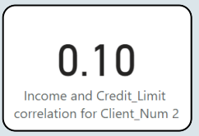
Income vs Credit Limit Correlation: Show the correlation between Income and Credit_Limit for all clients

Slide 17
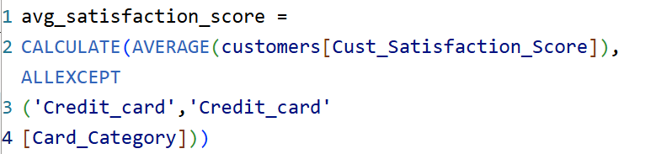
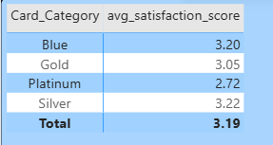
Average Customer Satisfaction Score by Credit Card Category: Calculate the average Cust_Satisfaction_Score by Card_Category.

Slide 18
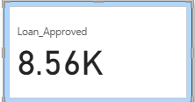
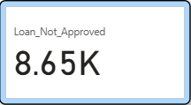
Loan Approval vs Credit Limit: Analyze how Credit_Limit affects Personal_loan approval by calculating the average credit limit for clients with and without loans.
Average Credit Limit (With Loan)
Average Credit Limit (Without Loan)

Slide 19
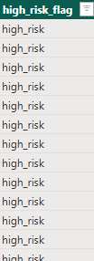
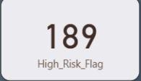
High Risk Clients Flag: Create a flag for clients whose Total_Revolving_Bal exceeds 90% of their Credit_Limit and who have a high Avg_Utilization_Ratio.

Slide 20

Thank you!
Feel free to reach out to us if you have any questions.
Phone Number
Email Address
portfolio
6377500510
shaktisinghsamer@gmail.com
https://www.wscubetech.com/portfolio/data/shakti-singh-shekhawat-znkvklr

